Slide 1
Interfaces, JUnit, etc...
#04 Let abstraction begin

Slide 2


Time & Sleep
work
work
sleep
12:00

Slide 3
Project Properties
pom.xml
<properties>
<project.build.sourceEncoding>UTF-8</project.build.sourceEncoding>
<maven.compiler.source>1.8</maven.compiler.source>
<maven.compiler.target>1.8</maven.compiler.target>
</properties>

Slide 4
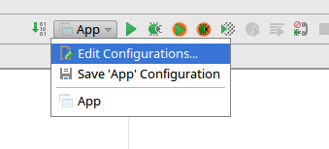
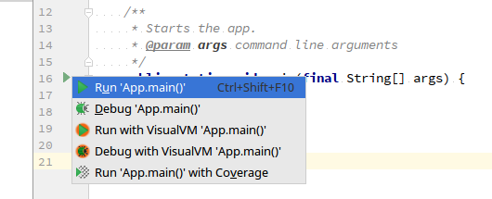
Run main() in IDEA

Slide 5
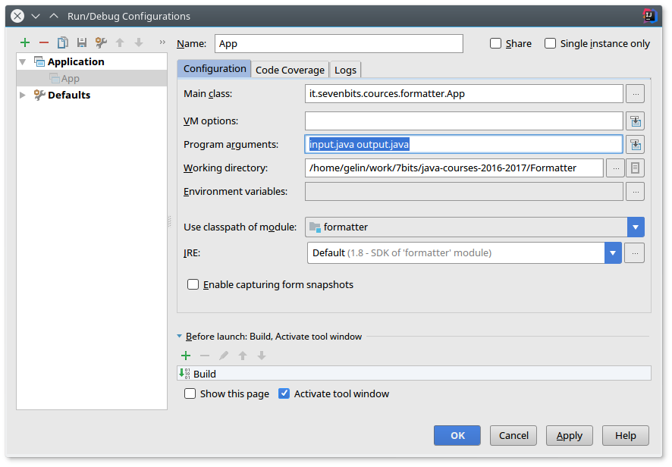
Run main() in IDEA

Slide 6
Input File Check
File sourceFile = new File(path);
if (!sourceFile.exists() || !sourceFile.canRead()) {
System.out.println("Can`t find/read the file!");
throw new FileNotFoundException();
}
Don't do this!

Slide 7
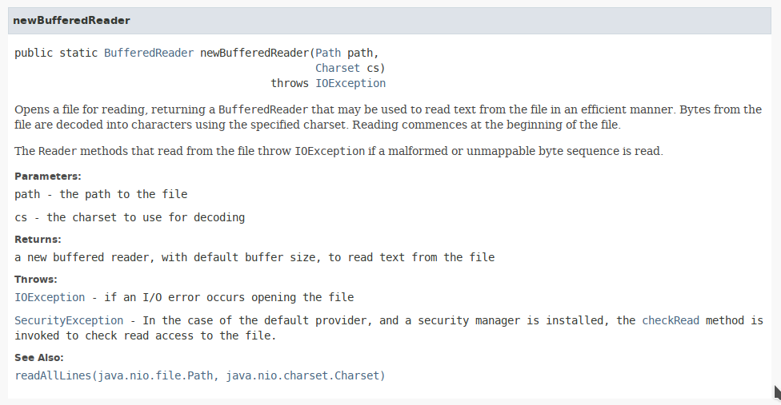

Slide 8
Output File Check
File file = new File(fileName);
try {
if(!file.exists()){
file.createNewFile();
}
FileWriter out = new FileWriter(file.getAbsoluteFile());
}
Don't do this!

Slide 9
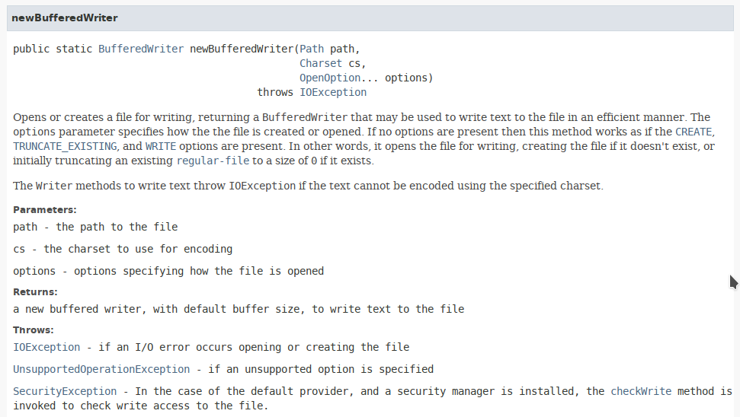

Slide 10
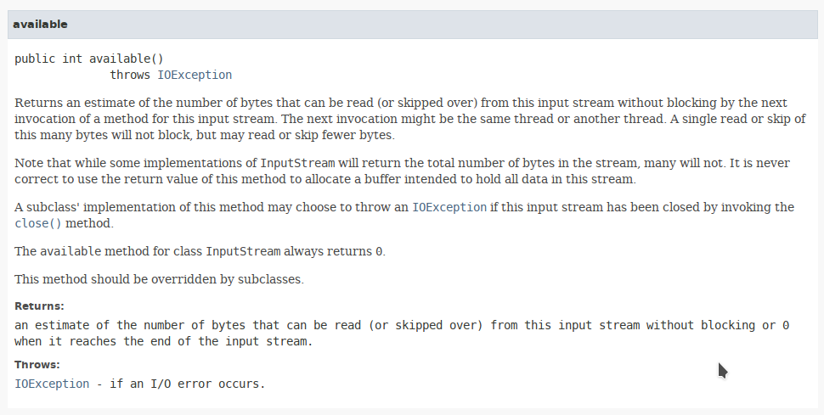

Slide 11
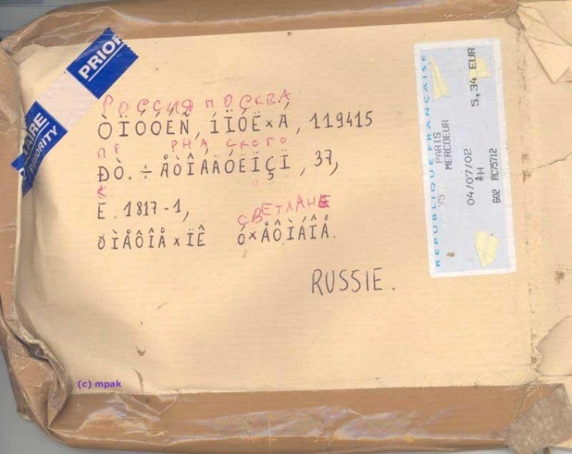
Кракозябры
— Don't
underestimate
the power
of charsets!
— Read chars,
Luke!

Slide 12
Three Approaches
By char
  Read char by char
  Write char by char
Whole text
  Read the whole text
  Regexp, substring, split, concatenation
  Write the whole text
Tree
  Read and parse the whole text to tree of blocks
  Write the tree with correct indentation

Slide 13

You Know Regular Expressions
Some people,
when confronted
with a problem, think
"I know, I'll use
regular expressions."
Now they have
two problems.

Slide 14
Three Approaches
 | Memory | Passes
By char | 1 char | one
Whole text | X*N chars | Z
Tree | Y*N chars | two

Slide 15
Line by Line
{ abc; def;
jkl(
mno,
pqr
); }

Slide 16
Interface
Polymorphism
Abstraction
Contract
Method signatures
No multiple inheritance

Slide 17
Interface
public interface WaterfowlRemoteController {
void swim(Direction dir);
}

Slide 18
Implementation
public class ToyDuckRemoteController
implements WaterfowlRemoteController {
public void swim(final Direction dir) {
//...
}
}

Slide 19
Substitution
WaterfowlRemoteController controller =
new ToyDuckRemoteController();
//...
controller.swim(GeoDirections.SOUTH);

Slide 20
java.util.List
List<String> listOfStrings;
listOfStrings.add("abc"); // add element
listOfStrings.size(); // collection size
listOfStrings.contains("abc"); // check existence
listOfStrings.get(0); // get element
for (String item : listOfStrings) {
// loop over elements
}

Slide 21
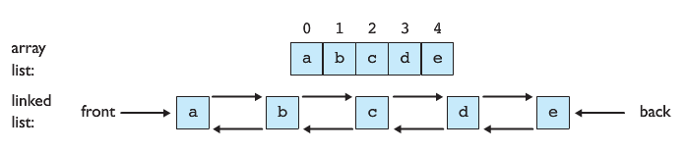
List Implementations
List<String> arrayList = new ArrayList<String>();
List<String> linkedList = new LinkedList<String>();

Slide 22
java.util.Map
Map<Integer, String> map;
map.put(5, "five"); // add value by key
map.size(); // count values
map.containsKey(5); // check key
map.containsValue("five"); // check value
map.get(5); // get value by key
for (Map.Entry<Integer, String> entry :
map.entrySet()) {
// loop over keys and values
entry.getKey(); // key
entry.getValue(); // value
}

Slide 23
Map implementations
Map<Integer, String> hashMap =
new HashMap<Integer, String>();
Map<Integer, String> treeMap =
new TreeMap<Integer, String>();

Slide 24
For-each Loop
List<String> list;
for (String s : list) {
// do something with s
}

Slide 25
Actually It's Iterator
List<String> list;
Iterator<String> i = list.iterator();
while (i.hasNext()) {
String s = i.next();
// do something with s
}

Slide 26
java.lang.Iterable<E>
Iterable<E> iterable;
Iterator<E> iterator = iterable.iterator();

Slide 27
java.util.Iterator<E>
Iterator<E> iterator;
boolean hasNextItem = iterator.hasNext();
// are there a next element?
E nextItem = iterator.next();
// gimme the next element
iterator.remove();
// delete the current element

Slide 28
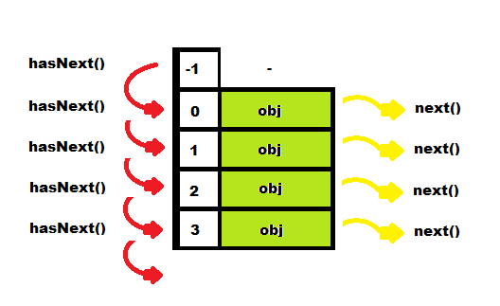
Iterator

Slide 29
Partial Interface Realization
@Override
public void remove() {
throw new UnsupportedOperationException(
"MyIterator cannot remove");
}

Slide 30
Exception
Some exceptional happens during execution.
Incorrect input data
File not found
Network connection lost
...

Slide 31
try
try {
// do something can throw exception
}

Slide 32
catch
try {
// do something can throw exception
} catch (IOException ioe) {
// do something with IO exception
} catch (Exception e) {
// do something with exception
}

Slide 33
catch (Java 8)
} catch (IOException | ArithmeticException e) {
// do something with exception
}

Slide 34
finally
try {
// do something can throw exception
} catch (Exception e) {
// do something with exception
} finally {
// do something on exit
}

Slide 35
throw
} catch (IOException e) {
throw new ReaderException(e);
}

Slide 36
throws
/**
* @throws FormatterException
* when formatting failed
*/
public void format(IReader in, IWriter out)
throws FormatterException {

Slide 37
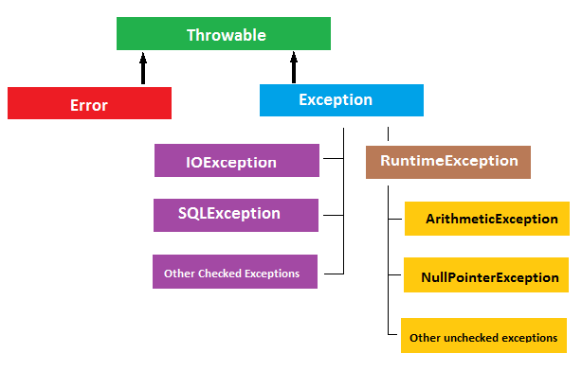
Exceptions
Hierarchy

Slide 38
Checked vs Unchecked
extends Exception
must be
  catched
  declared as throws
expresses recoverable errors
extends RuntimeException
no need to declare or catch
expresses occasional unrecoverable error

Slide 39
Part of Contract
public interface IFormatter {
void format(IReader in, IWriter out)
throws FormatterException;
}

Slide 40
Wrapping
public void format(IReader in, IWriter out)
throws FormatterException {
try {
// do format
} catch (Exception e) {
throw new FormatterException(
"format failed", e);
}
}

Slide 41
Exception Constructors
public Exception() {
public Exception(String message) {
public Exception(Throwable cause) {
public Exception(
String message, Throwable cause) {

Slide 42
try-with-resources (Java 7)
try (
Reader in = new FileReader("in.file");
Writer out = new FileWriter("out.file")
) {
format(in, out);
}

Slide 43
try-finally
Reader in = new FileReader("in.file");
Writer out = new FileWriter("out.file");
try {
format(in, out);
} finally {
if (in != null) in.close();
if (out != null) out.close();
}

Slide 44
AutoClosable
package java.lang;
public interface AutoCloseable {
void close() throws Exception;
}

Slide 45
Unit Testing
Continuous and constant
Easy to repeat
Concrete tests
Runs actual code
Each unit is tested independently
Test on each code change
Functional testing
Automated testing
Allowed to know the unit internals
Testing each method

Slide 46
Unit-tests — Good
Be sure in the code, can refactor
Test is a good documentation
Less debugging, more productivity
More independent units appears
More correct abstractions appears,
the test implementation appears

Slide 47
Unit-tests — Hard
Tests should be written, need a habit
Need to track test results for each version of code
Not possible to test everything:
security, functionality,
UI are hard to be tested automatically

Slide 48
Unit-tests — Dangerous
Tests can be erroneous,
correctness of all the units doesn't mean
the correctness of the whole system,
mocks are not real
Create a false sense of safety
It is tempting to disable non-working tests

Slide 49
JUnit
<dependencies>
<dependency>
<scope>test</scope>
<groupId>junit</groupId>
<artifactId>junit</artifactId>
<version>4.12</version>
</dependency>
</dependencies>
Maven scopes:
compile
provided
system
runtime
test

Slide 50
Test
import org.junit.Before;
import org.junit.Test;
import static org.junit.Assert.assertArrayEquals;
public class ArrayReverserTest {
private ArrayReverser reverser;
@Before
public void setUp() {
reverser = new ArrayReverser();
}
@Test
public void testReverse() {
int[] original = {1, 2, 3};
int[] reversed = reverser.reverse(original);
assertArrayEquals("wrong reverse",
new int[] {3, 2, 1}, reversed);
}
}

Slide 51
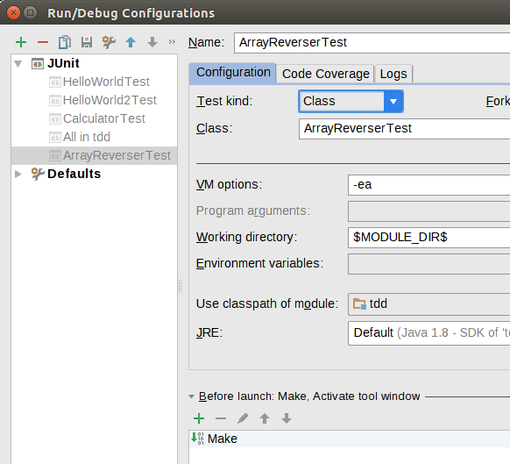
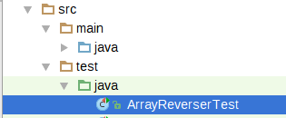
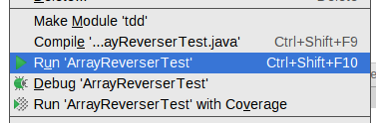
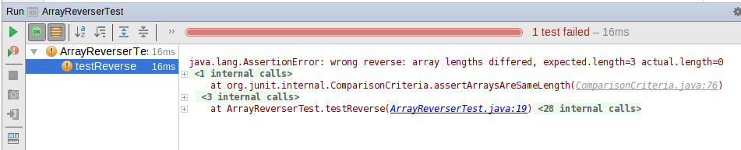
JUnit in IDEA

Slide 52
JUnit in Maven
% mvn package
[INFO] Scanning for projects...
[INFO]
[INFO] ------------------------------------------------------------------------
[INFO] Building tdd 0.0.1-SNAPSHOT
[INFO] ------------------------------------------------------------------------
[INFO]
...
-------------------------------------------------------
T E S T S
-------------------------------------------------------
Running ArrayReverserTest
Tests run: 1, Failures: 0, Errors: 0, Skipped: 0, Time elapsed: 0 sec
Results :
Tests run: 1, Failures: 0, Errors: 0, Skipped: 0
...
[INFO] ------------------------------------------------------------------------
[INFO] BUILD SUCCESS
[INFO] ------------------------------------------------------------------------
[INFO] Total time: 1.521s
[INFO] Finished at: Thu Mar 31 19:23:27 OMST 2016
[INFO] Final Memory: 9M/266M
[INFO] ------------------------------------------------------------------------

Slide 53
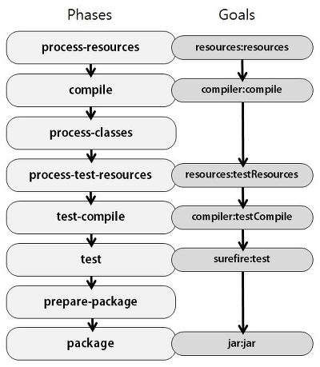
Maven lifecycle

Slide 54
JUnit in Maven
% mvn test
% mvn -Dmaven.test.skip=true package

Slide 55
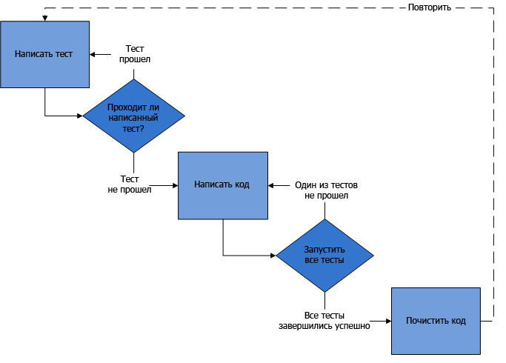
TDD

Slide 56
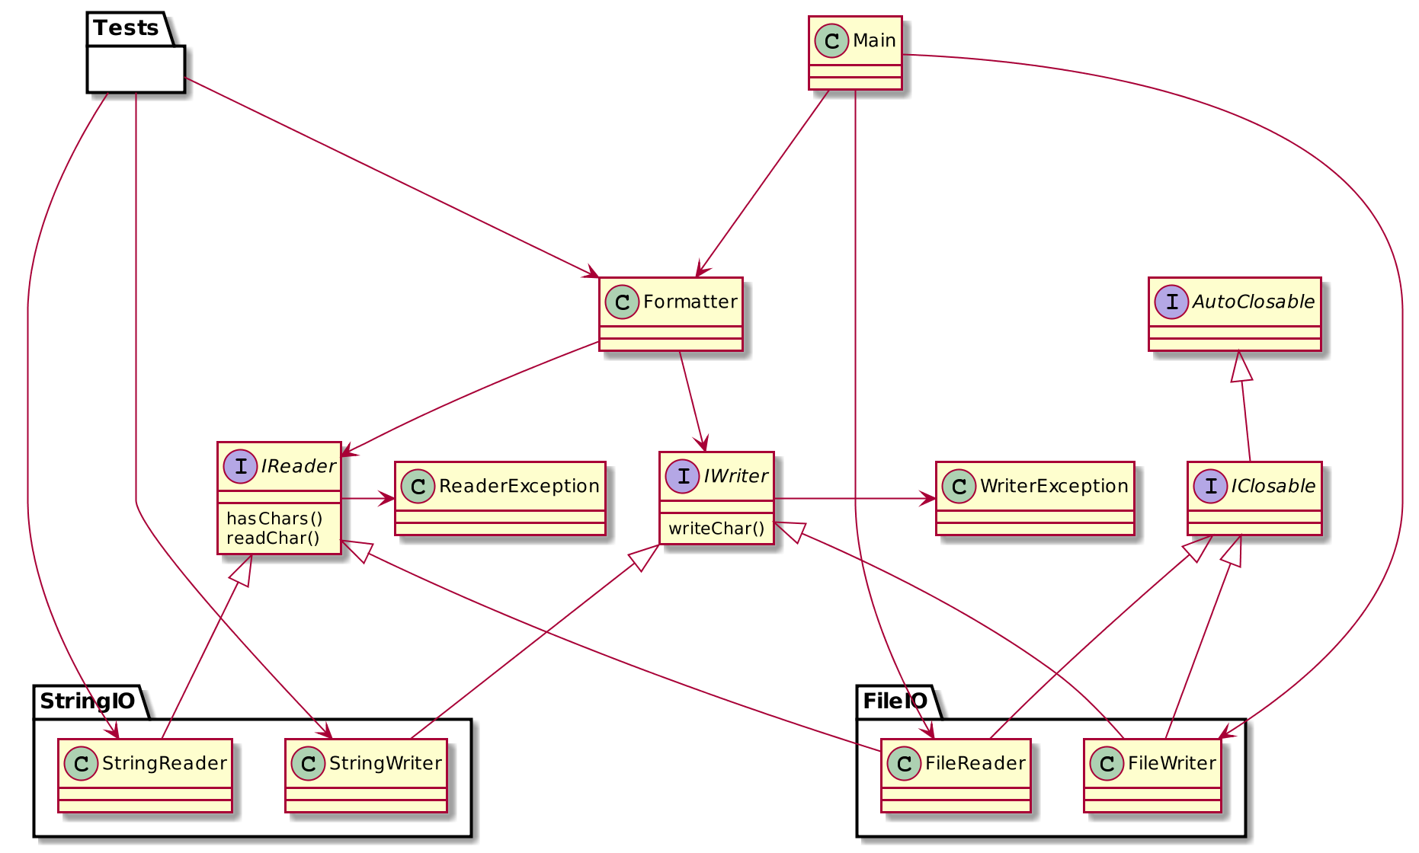
Formatter

Slide 57
Homework
IReader/IWriter interfaces and exceptions
String and File IO implementations
Tests of Formatter with String IO
To: denis.nelubin@7bits.it
Cc: back-teachers@7bits.it
Subj: Java Homework #04
Deadline: Sunday 23:59 (midnight)

Slide 58
Questions
teachers@7bits.it
back-teachers@7bits.it
https://7bits-courses.slack.com/messages/C7R2R4AMB/

